Slide 1
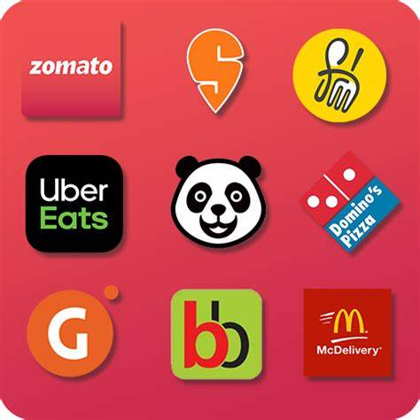
FOOD DELIVERY APPLICATIONS
Notes:
NOTE:
To change the image on this slide, select the picture and delete it. Then click the Pictures icon in the placeholder to insert your own image.

Slide 2
Introduction
Food delivery apps have become a central part of modern dining, leveraging sophisticated database management systems to provide efficient and reliable services. SQL (Structured Query Language) is instrumental in managing and querying the vast amounts of data these apps handle. For instance, SQL is used to store and retrieve information about restaurants, menus, customer orders, and delivery statuses.

Slide 3
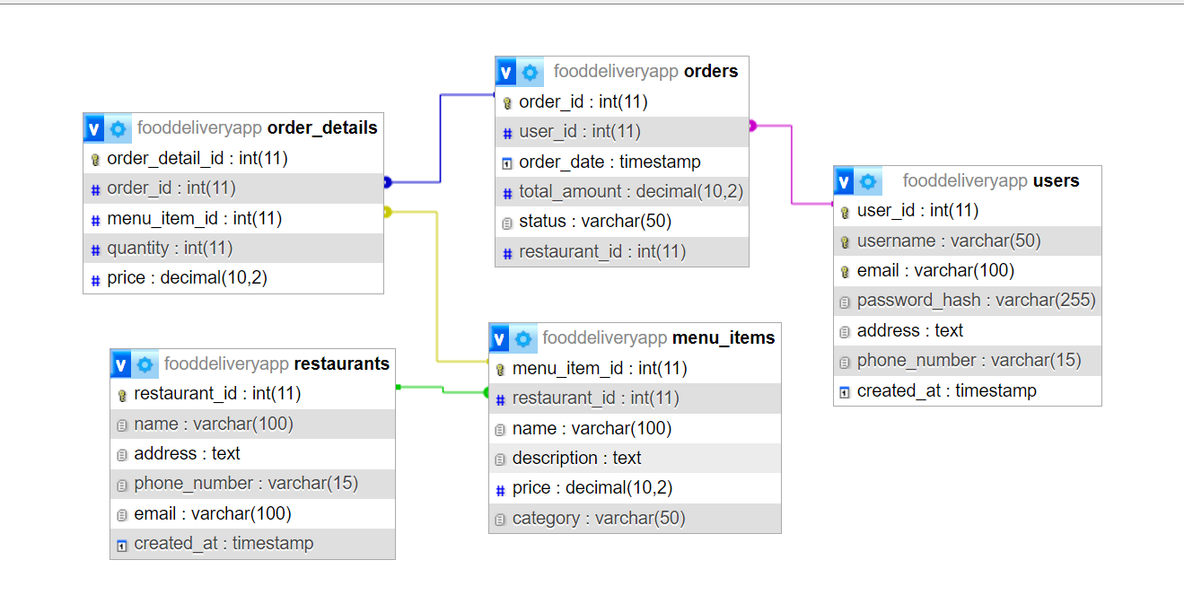
E-R Diagram

Slide 4
STRUCTURE OF TABLES

Slide 5
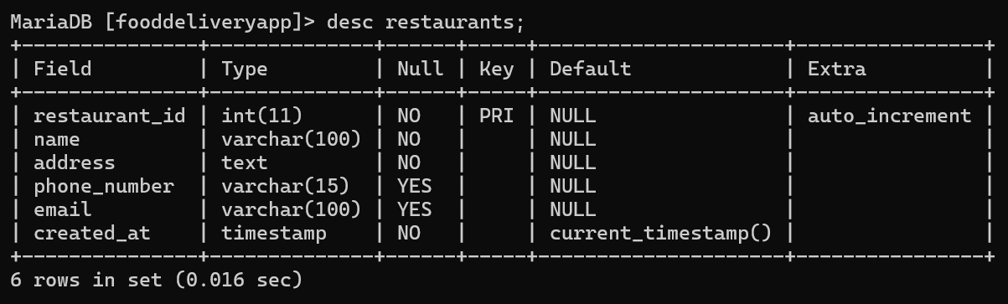
RESTAURANTS
CREATE TABLE RESTAURANTS (restaurant_id INT(11) NOT NULL AUTO_INCREMENT PRIMARY KEY,
name VARCHAR(100) NOT NULL,
address TEXT NOT NULL,
phone_number VARCHAR(15),
email VARCHAR(100),
created_at TIMESTAMP NOT NULL DEFAULT CURRENT_TIMESTAMP);
Info:
The RESTAURANTS table holds restaurant information with a unique restaurant_id,
name, address, optional phone_number, email, and a created_at timestamp for record creation.

Slide 6
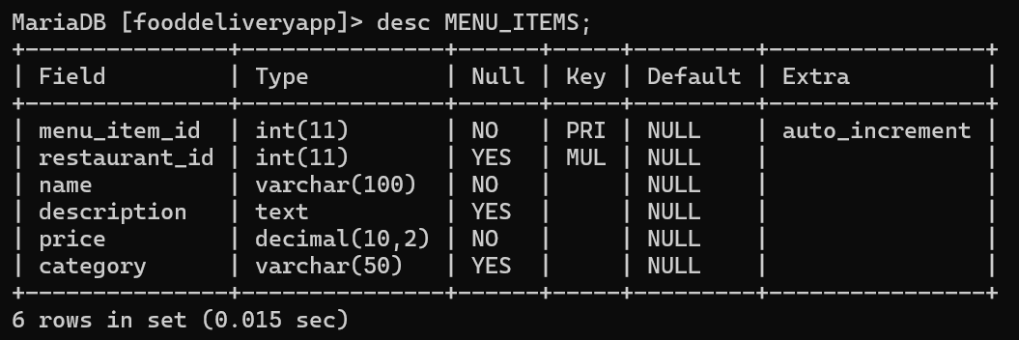
MENU_ITEMS
CREATE TABLE MENU_ITEMS (menu_item_id INT(11) NOT NULL AUTO_INCREMENT PRIMARY KEY,
restaurant_id INT(11),
name VARCHAR(100) NOT NULL,
description TEXT,
price DECIMAL(10,2) NOT NULL,
category VARCHAR(50),
FOREIGN KEY (restaurant_id) REFERENCES RESTAURANTS(restaurant_id));
Info:
The MENU_ITEMS table spices up your dining experience by cataloging each dish with a unique menu_item_id, linked restaurant_id, enticing name, description, price, and category.

Slide 7
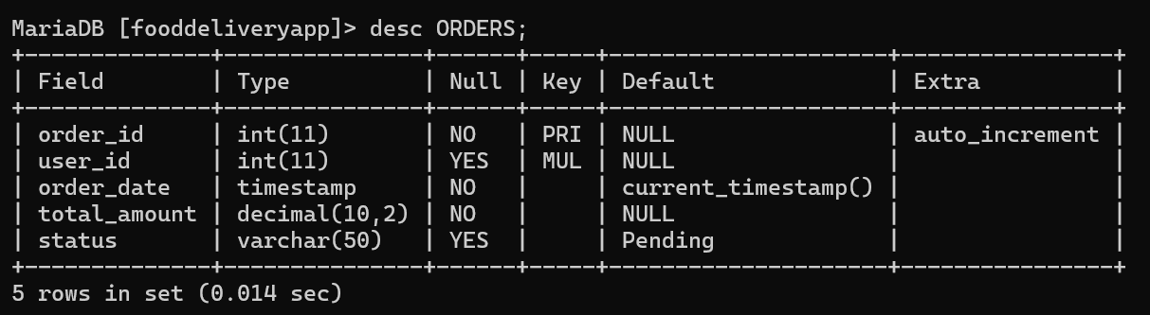
ORDERS
CREATE TABLE ORDERS (
order_id INT(11) NOT NULL AUTO_INCREMENT PRIMARY KEY,
user_id INT(11),
order_date TIMESTAMP NOT NULL DEFAULT CURRENT_TIMESTAMP,
total_amount DECIMAL(10,2) NOT NULL,
status VARCHAR(50) DEFAULT 'Pending');
Info:
The ORDERS table records each order with a unique order_id, linked user_id, timestamped order_date, total amount, and status, defaulting to "Pending", for effective order tracking.

Slide 8
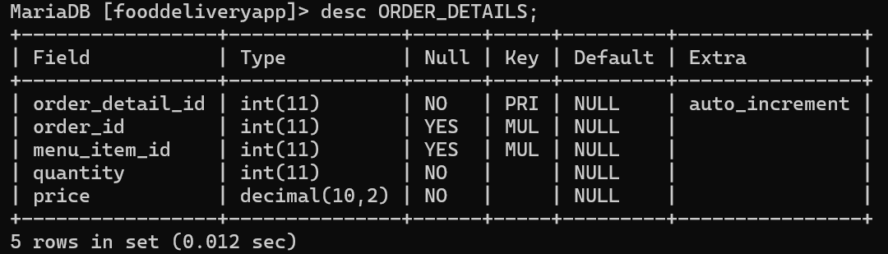
ORDER_DETAILS
CREATE TABLE ORDER_DETAILS (
order_detail_id INT(11) NOT NULL AUTO_INCREMENT PRIMARY KEY,
order_id INT(11),
menu_item_id INT(11),
quantity INT(11) NOT NULL,
price DECIMAL(10,2) NOT NULL,
FOREIGN KEY (order_id) REFERENCES ORDERS(order_id),
FOREIGN KEY (menu_item_id) REFERENCES MENU_ITEMS(menu_item_id));
Info:
The ORDER_DETAILS table captures each order’s specifics with a unique order_detail_id, linking order_id and menu_item_id, and detailing quantity and price for precise billing.

Slide 9
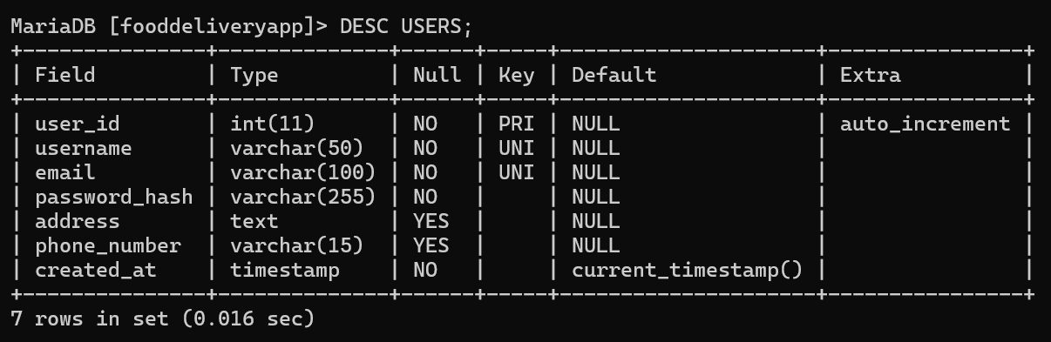
USERS
CREATE TABLE USERS (
user_id INT(11) NOT NULL AUTO_INCREMENT
PRIMARY KEY,
username VARCHAR(50) NOT NULL UNIQUE,
email VARCHAR(100) NOT NULL UNIQUE,
password_hash VARCHAR(255) NOT NULL,
address TEXT,
phone_number VARCHAR(15),
created_at TIMESTAMP NOT NULL DEFAULT CURRENT_TIMESTAMP);
Info:
The USERS table keeps track of user profiles with a unique user_id, username, email, secure password_hash, optional address and phone_number, and a timestamp for creation.

Slide 10
CONTENT OF TABLES

Slide 11
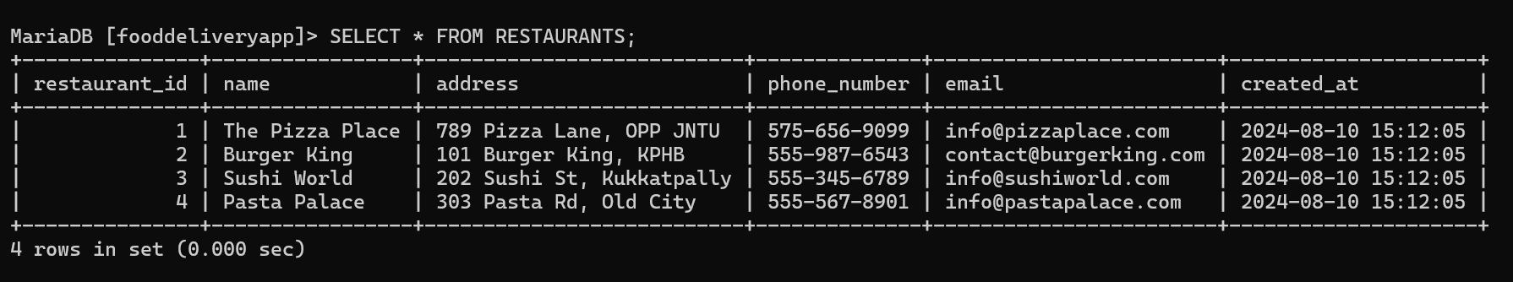
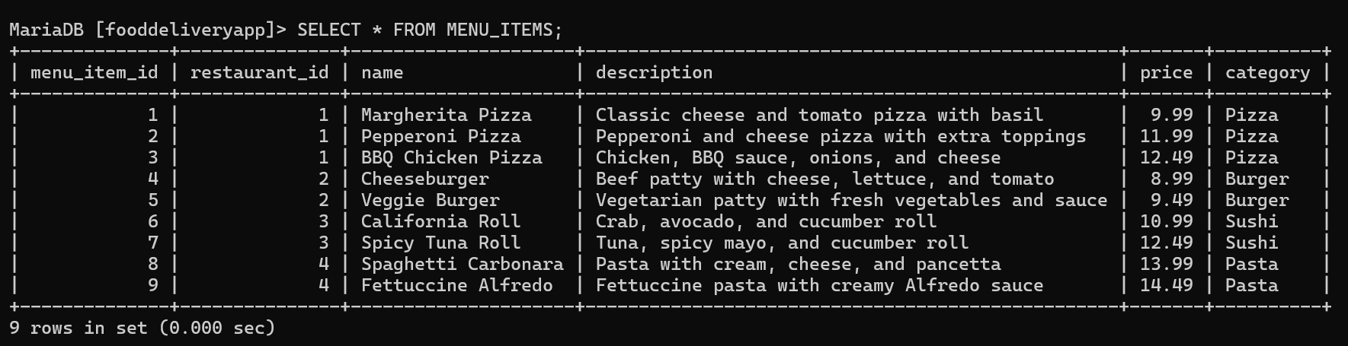
RESTAURANTS
MENU_ITEMS

Slide 12
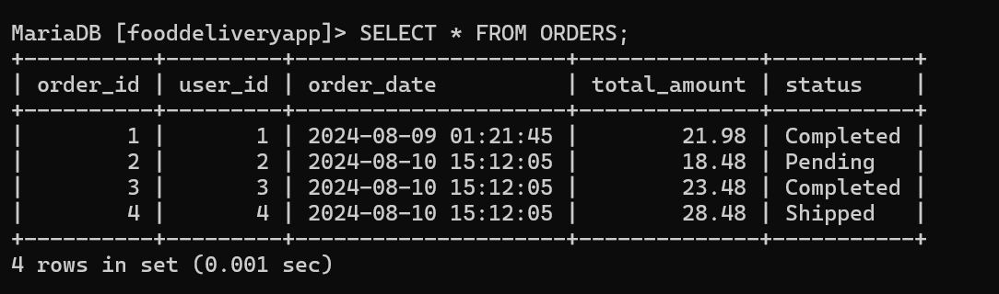
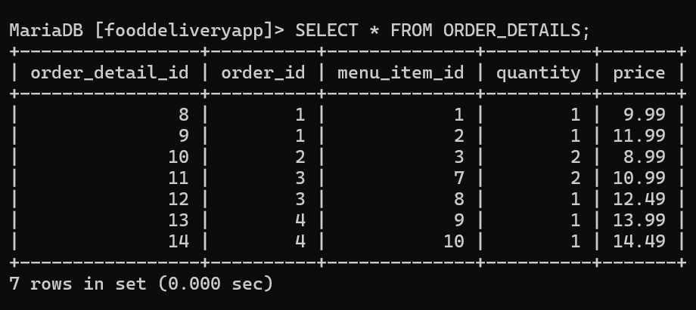
ORDERS
ORDER_DETAILS

Slide 13
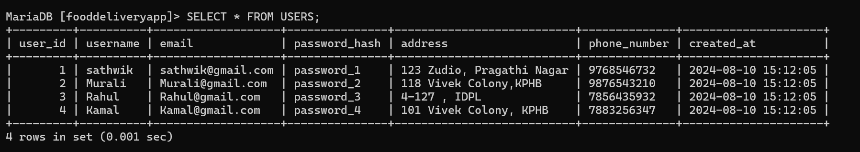
USERS

Slide 14
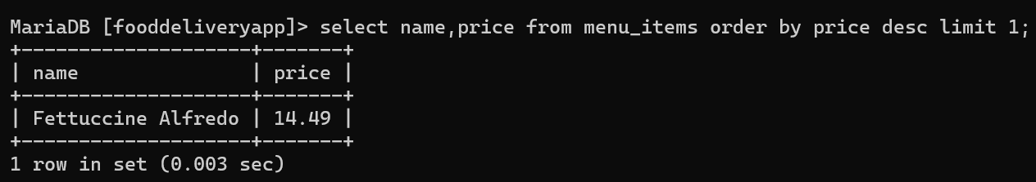
How can I find the most expensive menu item available?
SELECT name, price FROM menu_items ORDER BY price DESC
LIMIT 1;

Slide 15
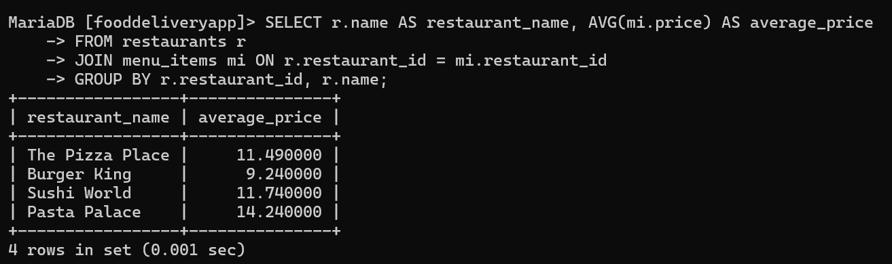
How can I find the average price of menu items for each restaurant?
SELECT r.name AS restaurant_name, AVG(mi.price) AS average_price
FROM restaurants r
JOIN menu_items mi ON r.restaurant_id = mi.restaurant_id
GROUP BY r.restaurant_id, r.name;

Slide 16
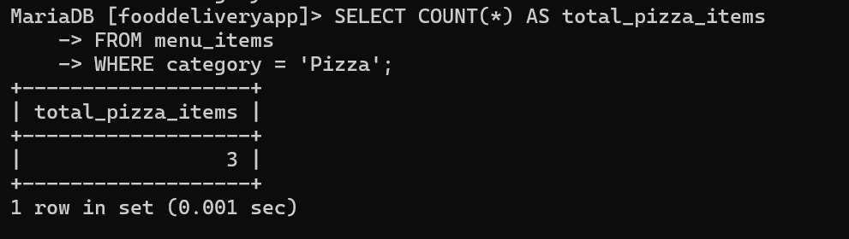
How can I find the total number of menu items in the "Pizza" category?
SELECT COUNT(*) AS total_pizza_items
FROM menu_items
WHERE category = 'Pizza';

Slide 17
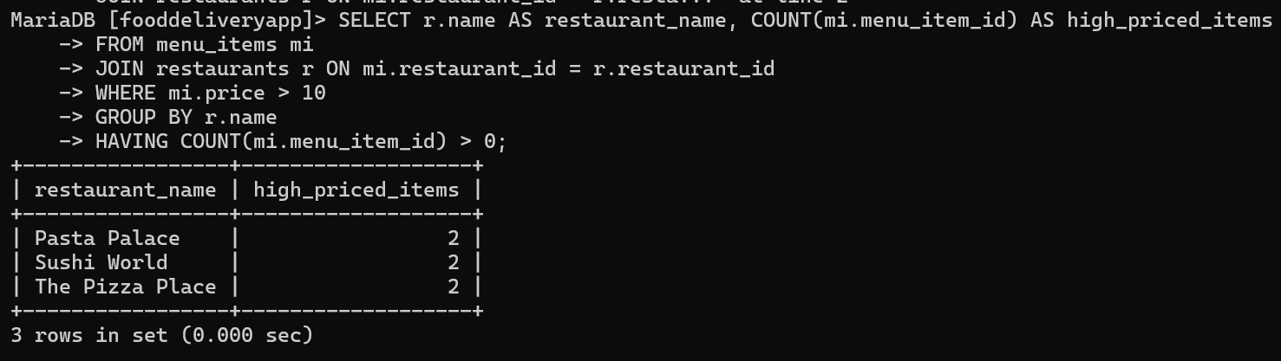
Restaurants with Menu Items Priced Above $10
SELECT r.name AS restaurant_name, COUNT(mi.menu_item_id) AS high_priced_items
FROM menu_items mi
JOIN restaurants r ON mi.restaurant_id = r.restaurant_id
WHERE mi.price > 10
GROUP BY r.name
HAVING COUNT(mi.menu_item_id) > 0;

Slide 18
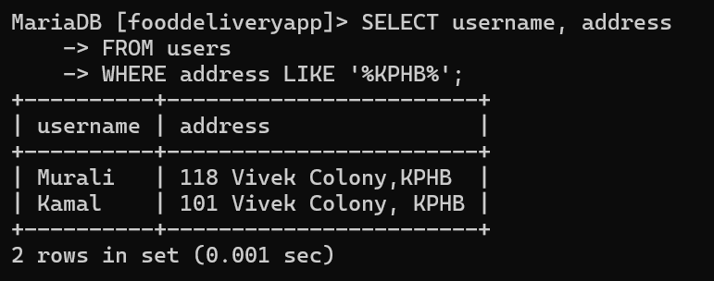
How can I find all users whose addresses are located in "KPHB"?
SELECT username, address
FROM users
WHERE address LIKE '%KPHB%';

Slide 19
BUILT IN FUNCTIONS

Slide 20
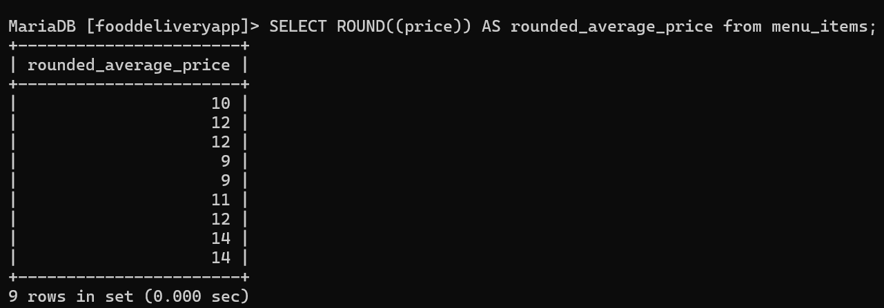
How to Round numbers to the Nearest Integer or Decimal Place in price column?
SELECT ROUND((price)) AS rounded_average_price from menu_items;

Slide 21
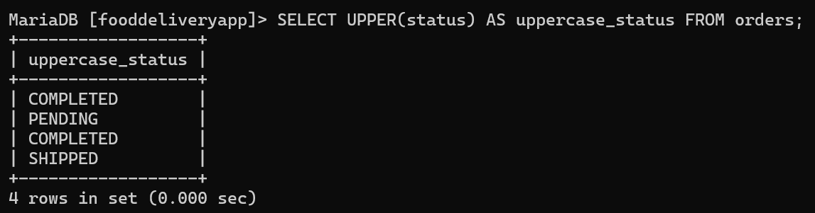
How can I display status in uppercase from orders table?
SELECT UPPER(status) AS uppercase_status FROM orders;

Slide 22
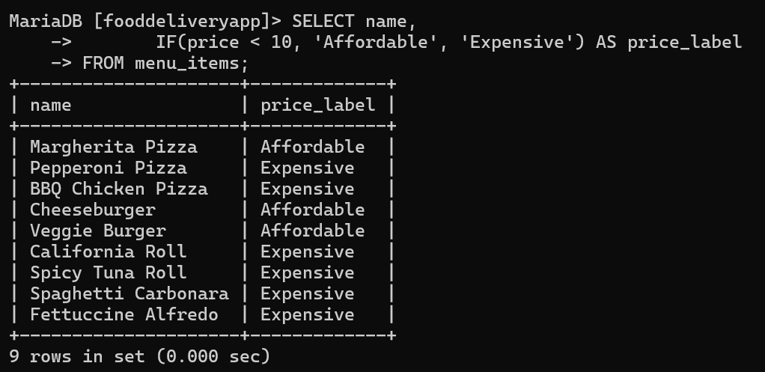
How can I label menu items as "Affordable" if their price is under $10, otherwise "Expensive"?
SELECT name, IF(price < 10, 'Affordable', 'Expensive') AS price_label FROM menu_items;

Slide 23
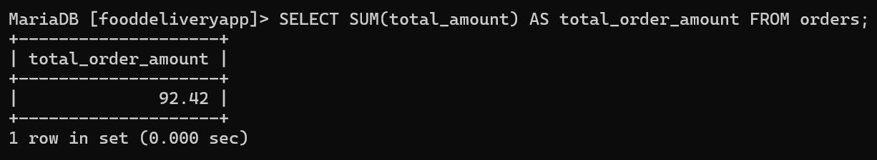
What is the total amount of all orders placed?
SELECT SUM(total_amount) AS total_order_amount FROM orders;

Slide 24
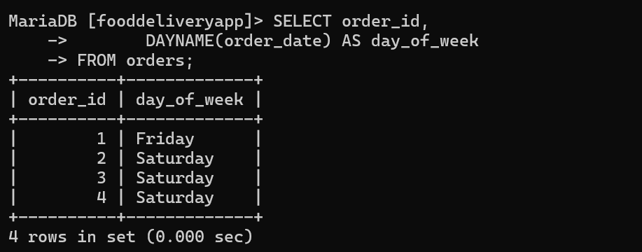
Getting the Day of the Week from Order Dates
SELECT order_id, DAYNAME(order_date) AS day_of_week FROM orders;

Slide 25
SUB-QUERIES

Slide 26
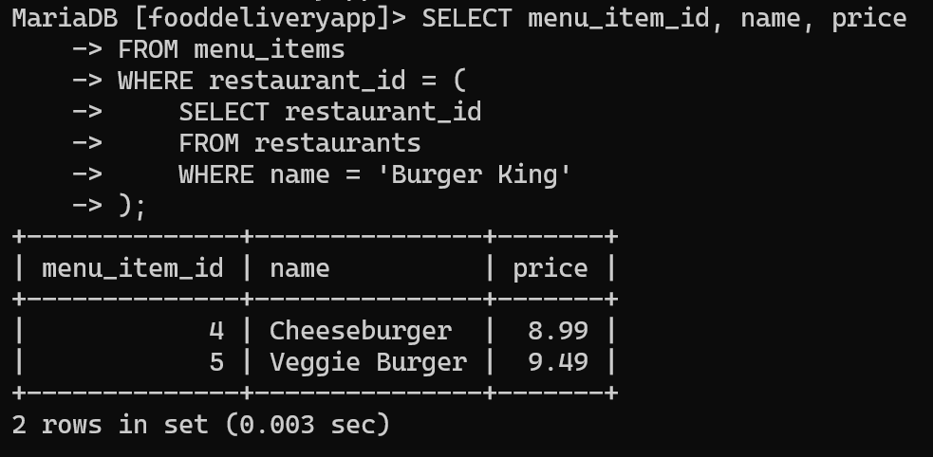
Retrieve all menu items for the restaurant with restaurant_id
SELECT menu_item_id, name, price
FROM menu_items
WHERE restaurant_id = ( SELECT restaurant_id FROM restaurants WHERE name = 'Burger King');

Slide 27
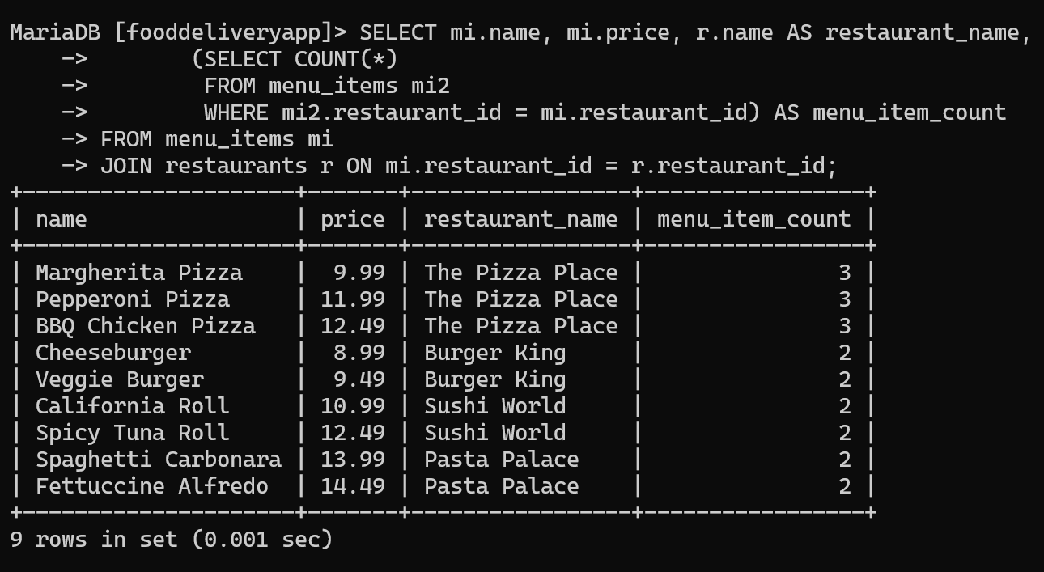
Retrieve Menu Items with the Count of Menu Items in Their Restaurant
SELECT mi.name, mi.price, r.name AS restaurant_name, (SELECT COUNT(*) FROM menu_items mi2 WHERE mi2.restaurant_id = mi.restaurant_id) AS menu_item_count FROM menu_items mi JOIN restaurants r ON mi.restaurant_id = r.restaurant_id;

Slide 28
JOINS

Slide 29
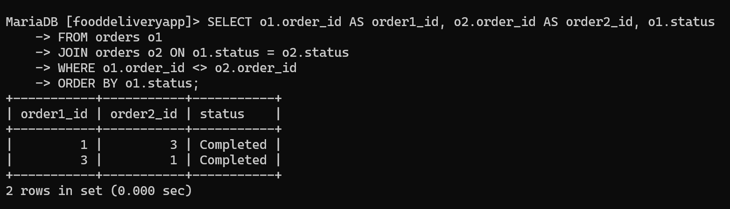
Find Orders with the Same Status
SELECT o1.order_id AS order1_id, o2.order_id AS order2_id, o1.status FROM orders o1 JOIN orders o2 ON o1.status = o2.status WHERE o1.order_id <> o2.order_id ORDER BY o1.status;

Slide 30
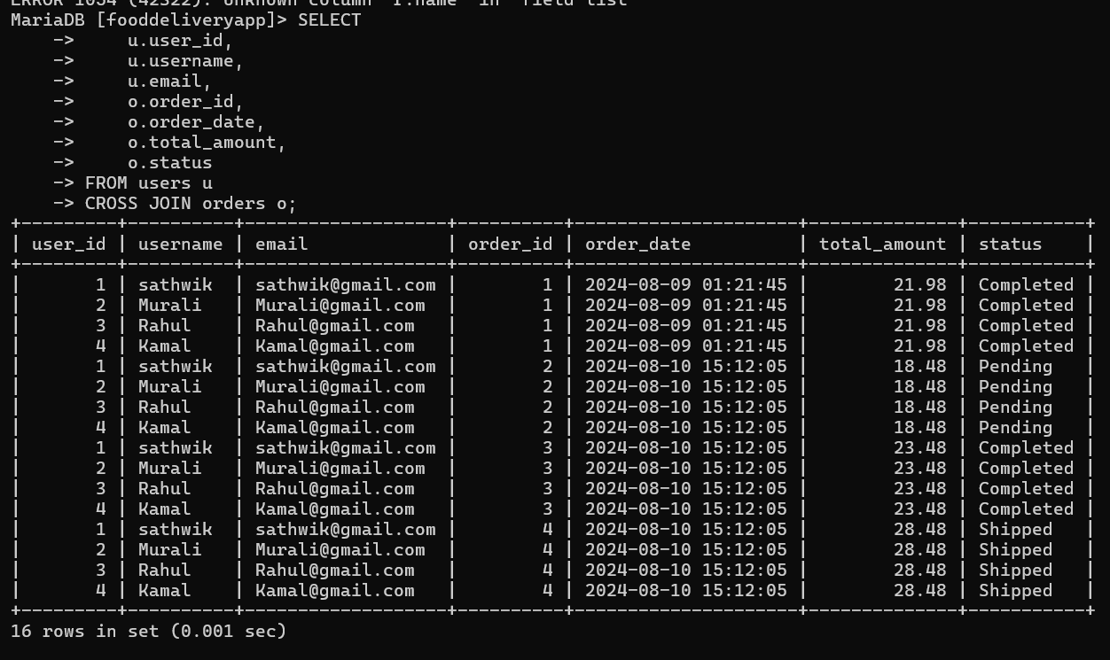
All Possible Combinations of Users and Orders Using CROSS JOIN
SELECT u.user_id, u.username, u.email, o.order_id, o.order_date, o.total_amount, o.status FROM users u CROSS JOIN orders o;

